Slide 1

POLICY POINT
POLICY: GBCB Staff Conduct
The Board of Education expects that each professional and support staff member shall put forth every effort to promote a quality instructional program in the school district. In building a quality program, employees must meet certain expectations that include, but are not limited to, the following:
#14: Teachers should be:
Neat, clean and dress in a professional manner at all times. Professional dress does not include blue jeans or shorts
Body piercings, other than in ears, should not be worn when performing one’s duty as an educator in the Joplin Schools.
Acceptable earrings do not include gauge or plug style earrings.
Employees with tattoos shall cover the tattoo with clothing or by other appropriate means.

Slide 2
EFFECTIVE CLASSROOM MANAGEMENT
PROPAGATES
APPROPRIATE BEHAVIOR
SO…..

Slide 3
Teachers must “look” the part.

Slide 4

DRESS
FOR THE
JOB

Slide 5
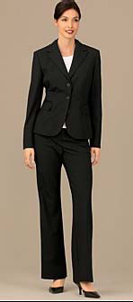
Professional Business Dress

Slide 6
Professional Business Dress

Slide 7

Business Casual

Slide 8
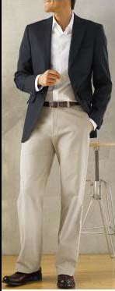
Business Casual
Business Casual is NOT SLOPPY!

Slide 9
BUSINESS CASUAL
AND
CASUAL
ARE NOT THE SAME!

Slide 10
PROFESSIONAL DRESS
Dress for Success
  Not for a night out on the town.
Dress as a Role Model
  You represent Joplin Schools at all time.
Dress for Decency
  If it’s questionable in your mind – it’s questionable.
Dress for Safety
  Shoes should be practical
Dress for Respect
  Your dress is a reflection of your professionalism.

Slide 11
UNPROFESSIONAL DRESS
Low riding pants
Plunging necklines
Tight clothes
Sloppy T-Shirt
Spaghetti Straps
Short Skirts
    Which includes short sweater dresses
What about HAIR?!

Slide 12
Administrative Guide
Dress, grooming, and appearance may be regulated by school boards if compelling educational interest is demonstrated or if such codes are supported by community standards.

Slide 13
QUICK REMINDERS
Board Policy GBCD, Staff Conduct, stipulates that each professional and support staff member will become familiar with, enforce and follow all Board policies, regulations, administrative procedure, other directions given by district administrators and state and federal laws as they affect the performance of job duties.
Board Policy GCPE, Termination of Professional Staff Members states that willful or persistent violation of or failure to obey the published regulations of the Board of Education of the school district are cause for termination.

Slide 14
FINAL POINT
It’s not only okay to have the conversations about appropriate dress for staff….
It’s Expected.

